Slide 1
Finding Apprenticeships on Unifrog
Follow the next few slides to look for Apprenticeships

Slide 2
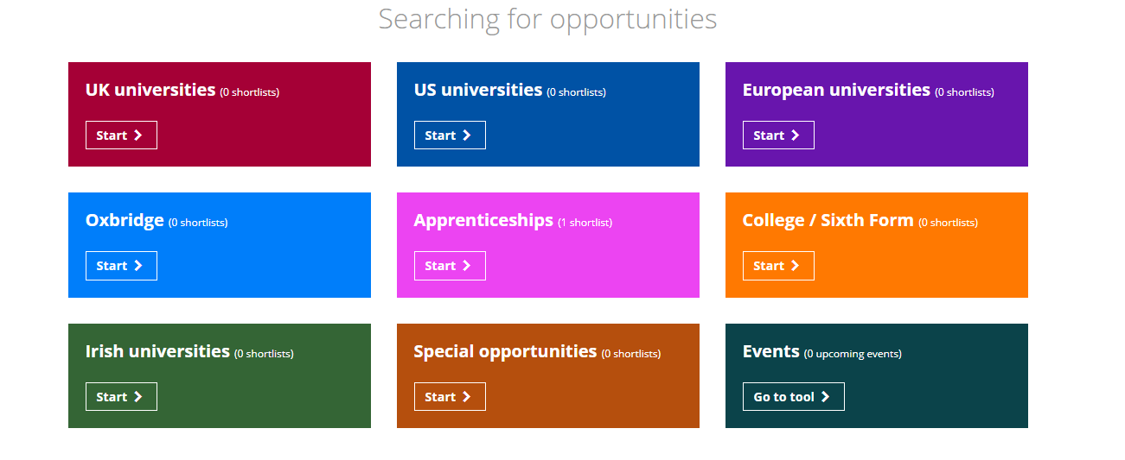

Slide 3
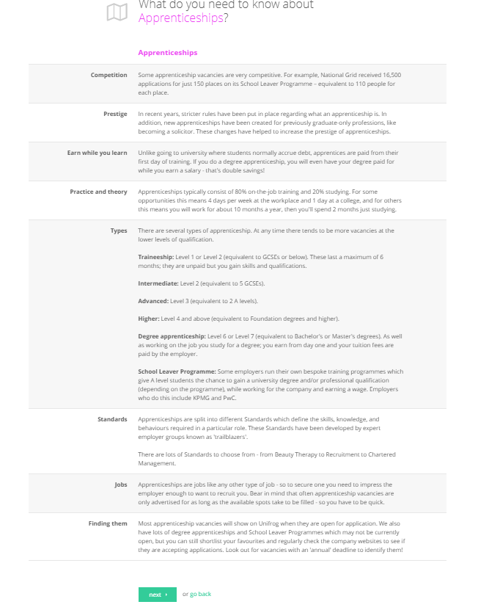

Slide 4
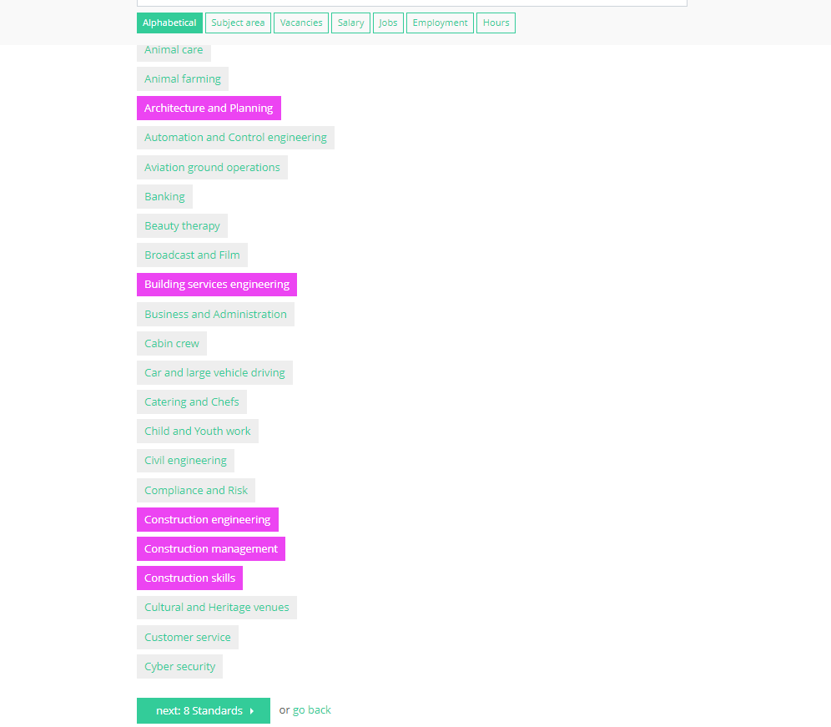
Select all the areas you are interested in .

Slide 5
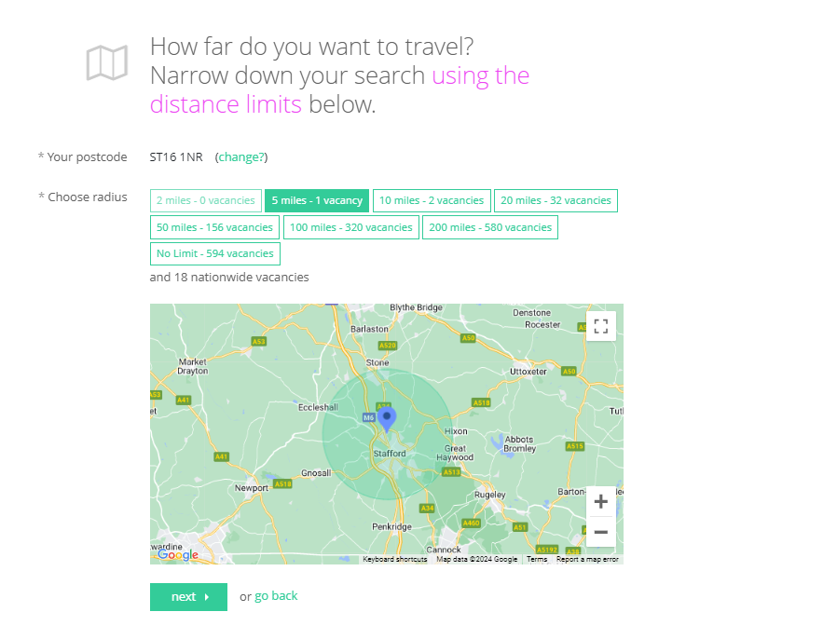
How far are you prepared to travel, remember there is life after Stafford . We have a great train, bus and motorway link.

Slide 6
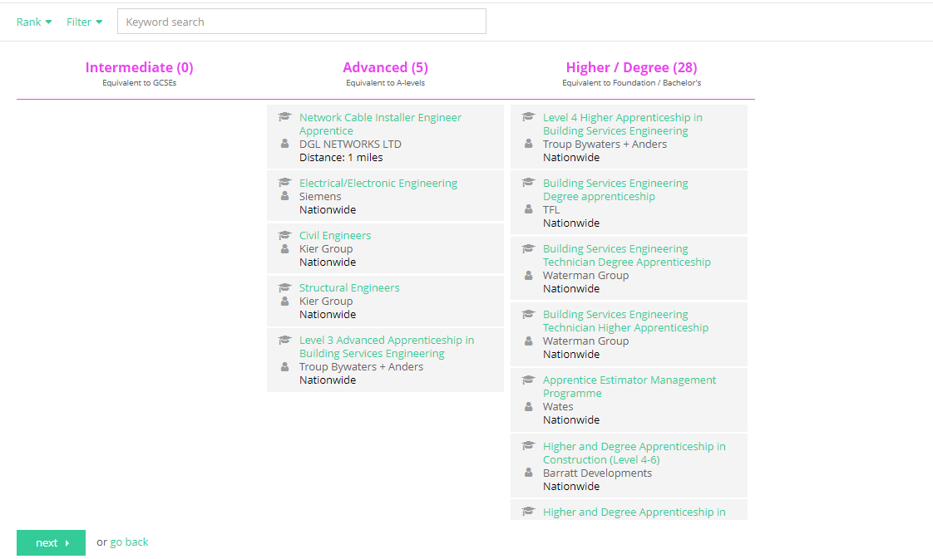

Slide 7
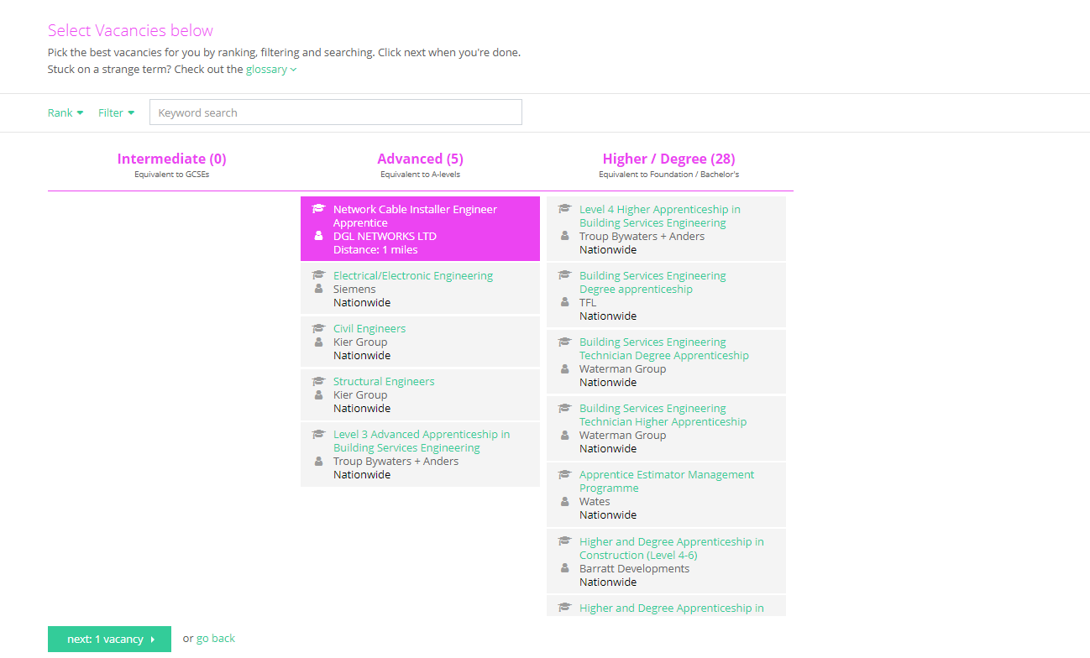
Select an apprenticeship and press next

Slide 8
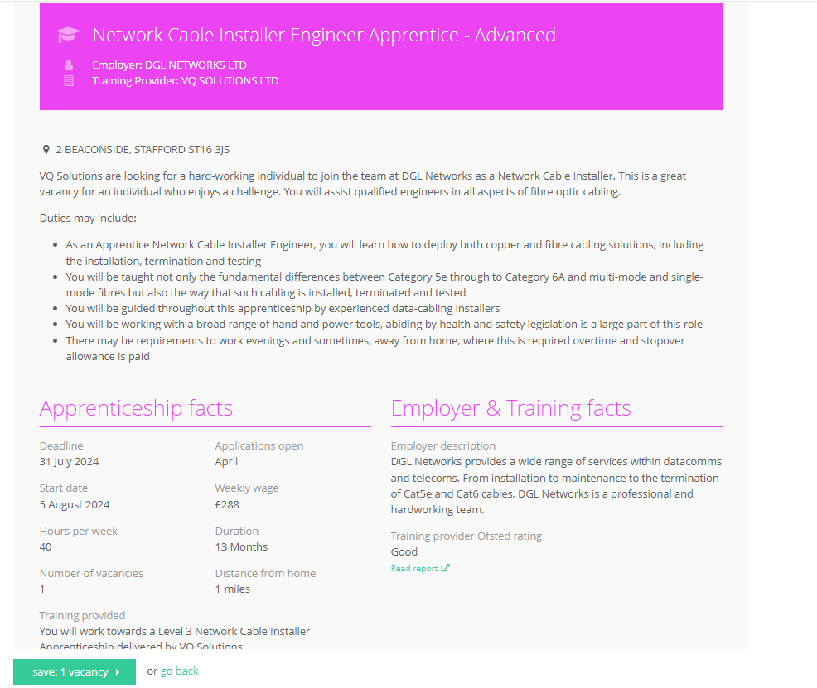
If you are interested SAVE it and move on to look at others.

