Slide 1


Post 16 Option Evening

Slide 2

Why this evening?
Important to keep everyone not just pupils updated .
Parents are so important in the process of pathways.
Never too young to start thinking about your future.
Welcome:
Mrs Jones – Head of 6th Form
Martyn Williams- School Liaison Officer (NSCG)
Steven Rogers – The Careers Hub

Slide 3
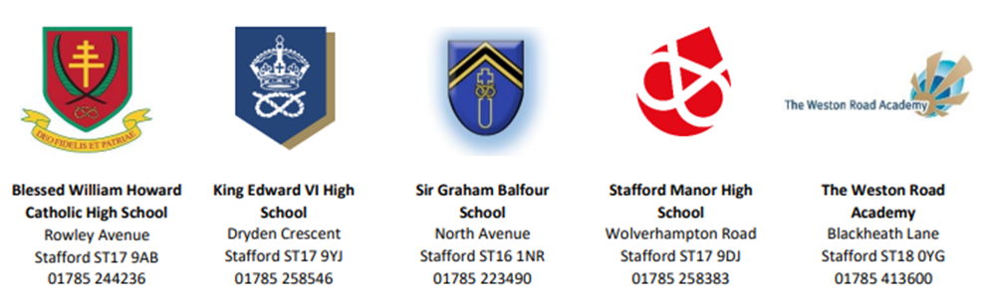

A Levels – Stafford Partnership

Slide 4
Studying A levels with the Sixth Form Partnership – Curriculum Programme
At SGB:
English Literature
French
PE
Maths
Psychology
Art
Biology
Business Studies
Geography
Physics
Chemistry
Computing
History
In the partnership:
Economics
Sociology
Sports and Physical Activity (BTEC)
Health and Social Care (BTEC)
Law
Philosophy and Ethics
Criminology
English Language

Slide 5
Studying A levels with the Sixth Form Partnership- Entry Requirements
To study at the Stafford Partnership you will need:
7 grade 4-7 GCSEs including Maths and English.
A 5 in the subject you wish to study (or related subject if not studied at GCSE).
A grade 6 to study Maths, Sciences or MFL.
You are required to study Maths if you are going to study Physics.

Slide 6
Studying A levels with the Sixth Form Partnership - Application Process
17th October 2024 – Open Evening
October – Pathways meetings
31st January – Application deadline
February/March – Acceptance confirmation
July – Transition Week
August – Results day and enrolment
You can continue to make changes to your subjects until the beginning of Y12. You can make more than one application to keep options open.

Slide 7
Studying A levels with the Sixth Form Partnership – Enrichment
Trips and Visits
Enrichment, charity projects, post-18 related, subject specific, cultural, team building, partnership
Additional Qualifications
Extended project qualification, Duke of Edinburgh
Careers IAG
Outside speakers, company and university outreach days, 121 meetings, guidance with research and applications, work experience, university offer schemes and summer schools
PHSE and Mentoring

Slide 8

and apprenticeship study programmes
Schools Liaison Officer
Martyn Williams – martyn.williams@nscg.ac.uk

Slide 9
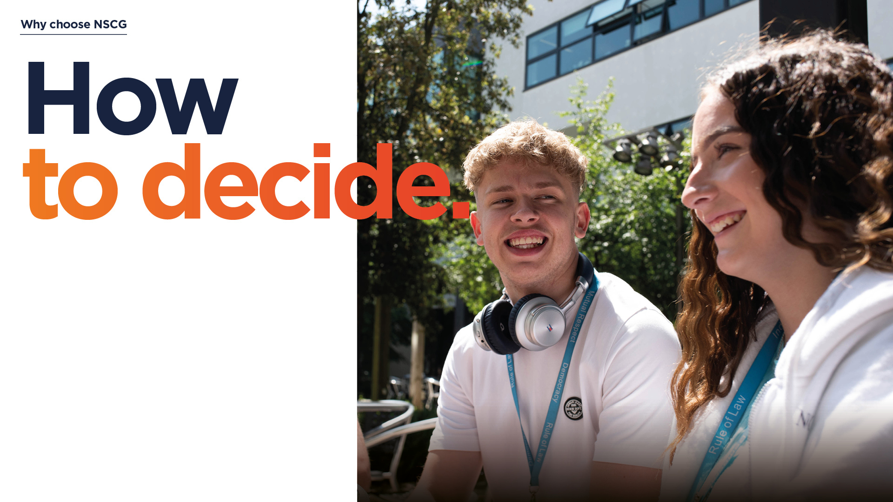
4 start points to choose a course:
1: You know what job you want to do...
2: You know what you want to study at university...
3: You know which subjects you’re good at...
4: You know which subjects you enjoy...

Slide 10
T-Level?
The T stands for - Technical
Prepares students on full-time study programmes for work by connecting full-time learners with the industry.

Slide 11
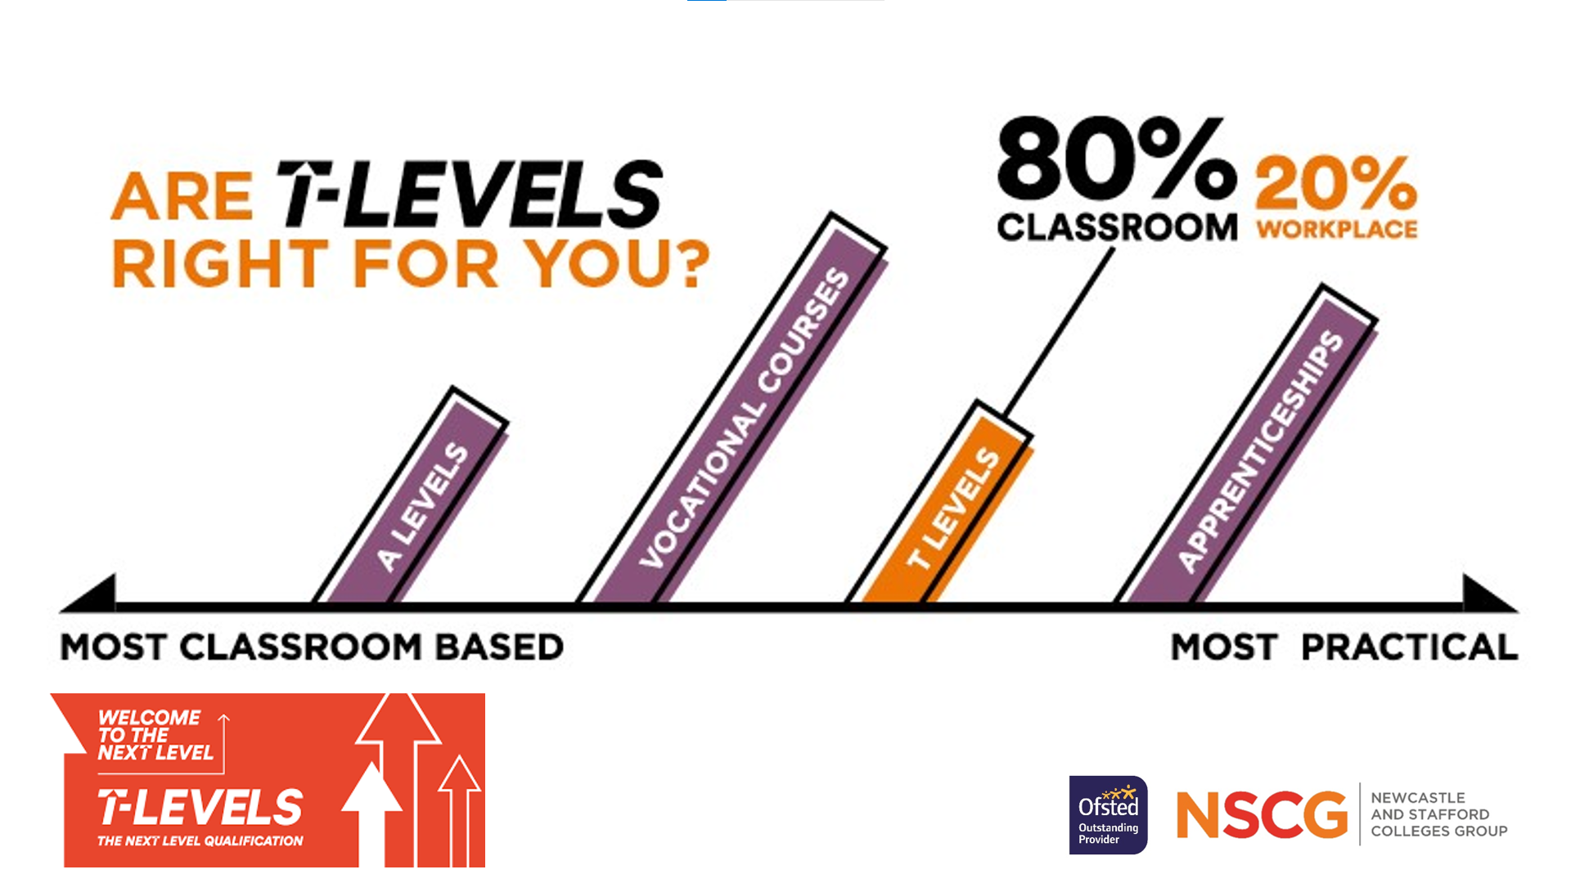

Slide 12

A Level & A+ Programmes
Sixth Form Academic
Route (Level 3)
Quick overview:
• Choose 3 subjects (or 2 & 1
A+)
• Study each subject
individually
• Study 5 days per week (15
hours)
• Primarily exam based
• Demanding entry
requirements
5 GCSEs at Grade 5-9
(STEM require 6’s in science and Maths and a 6 average)
• You must have GCSE English
& Maths at Grade 5 or above
T-Levels
T-Level
Route (Level 3)
Quick overview:
• Choose 1 subject
• Assessed industry placement
• 80% classroom, 20% work
• Equivalent to 3 A Levels
• Demanding entry
requirements
5 GSCEs at Grade 5-9
• You must have GSCE English
& Maths at Grade 5 or above
Vocational Programmes
Vocational
Route (Level 3)
Quick overview:
• Choose 1 subject
• Subject broken into units
• Study 3-5 days per week (14-15
hours)
• Primarily coursework based
• Equivalent to 3 A Levels (Level
3 BTEC)
• Entry requirements
5 GSCEs at Grade 4-9
Some subjects require
additional GSCEs i.e.
Engineering & Sport
• You must have GSCE English
OR Maths at Grade 4 or above
Apprenticeships
Available at Levels 2 to 5
Quick overview:
• If you know exactly what
career you want
• Spend 4 days at work, 1 day
in college
• Get paid to learn
• Study up to degree level*
• 2-4 GSCEs at Grade 4-9
Most Employers prefer 5
GCSEs at Grade 5 or above
• Employers may ask for
specific subjects
• You must have GCSE English
OR Maths at Grade 4 or above
Progression & Skills Pathways
Level 2, Level 1 & Entry Level
Quick overview:
If you’re not quite ready to join a Level 3 programme, our vocational Progression Pathways allow you to study at Entry Level, Level 1 or Level 2 and will prepare you to progress onto a higher level.
Alternatively, if you want skills based training in areas such as hairdressing, beauty and construction, you’ll start your journey on a Level 1 Skills Pathway, before progressing to higher levels.
GCSE Maths & English
If you haven’t yet achieved grades 9-4 in these important subjects, Maths and/or English sessions will be on your timetable and you’ll retake qualifications alongside your main course.

Slide 13
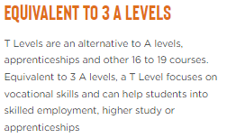
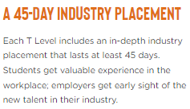
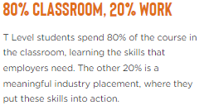
T-levels – key facts

Slide 14
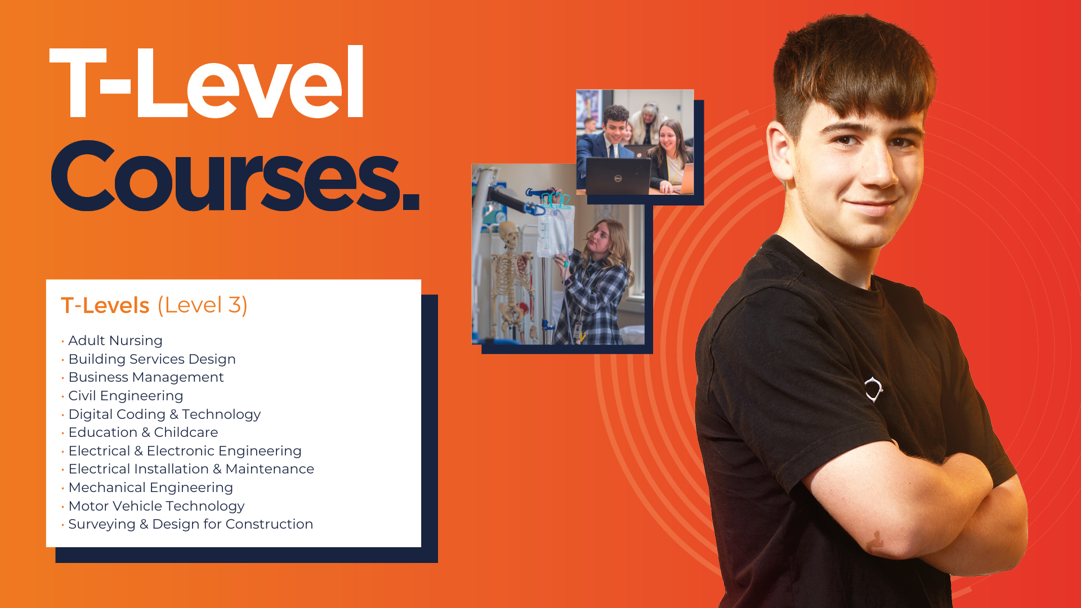
This is you:
I want to gain hands on work experience
I want to put the theory I'm learning into practice
I have a career in mind
I want to go on to university, get an apprenticeship or get a job

Slide 15
Industry placements
We work with a wide range of employers to offer meaningful industry placements.
Students are guided through the process to secure their placement with curriculum support.

Slide 16

If this is you:
• I want to gain hands-on work experience, with an extended industry placement
• I want to put the theory I’m learning into practice
• I have a career in mind
• I want to go on to university, get a higher apprenticeship or a job
Then a T-Level could really work for you!
T Levels (Level 3)
Building Services Design
Business Administration
Digital Coding & Technology
Education & Childcare:
-Assistant Teaching
-Supporting Early Years
Electrical & Electronic Engineering
Healthcare:
-Adult Nursing
-Midwifery
Legal Services:
-Business & Finance
-Crime & Social Welfare
Mechanical Engineering
Vehicl﻿e Maintenance & Repair
Notes:
Stafford

Slide 17

Your study options:
Intermediate Apprenticeship (Level 2)
The Level 2 Apprenticeship is equivalent to five GCSEs at grade 9-4.
Advanced Apprenticeship (Level 3)
The Level 3 Apprenticeship is equivalent to two A Levels.
Higher Apprenticeship (Levels 4-5)
The Level 4-5 Apprenticeship is equivalent to a university-level programme such as a Foundation Degree or HNC/HND.
The Apprenticeship Hub
The Apprenticeship Hub is a free service where you can find an apprenticeship and get advice on all aspects of employment, including writing a CV, interview preparation tips and help in finding the right apprenticeship for you.
Get in touch!
E: apprenticeships@nscg.ac.uk
T: 01782 254287 (Newcastle) - 01785 275660 (Stafford)
Our Subjects
Engineering (Mechanical and Electrical)
Engineering Production & Design
General Welding
Hair Professional
Healthcare
Hospitality
Land based Service
Engineer
Learning Mentor
Lean Manufacturing
Motor Vehicle Service
and Maintenance
Operations and Department
Management
Teaching Assistant
Team Leading
Adult care
Accounting
Advanced & Creative Hair
Barbering
Beauty Therapist
Brickwork
Business
Administration
Carpentry & Joinery
Catering
Customer Service
Digital Marketing
Digital Technician
Early Years
Electrical Installation & Maintenance
Key facts
• The majority of apprentices self source a placement
• A ‘Provider’ is needed for the study day and to assign an assessor
• Can be started at any time/age
• You can apply for an apprenticeship at a at same time as fulltime college course, subject to finding a placement

Slide 18
How will this course be delivered?
A two-year, technical study programme, designed with employers to develop the skills that industry needs.
Year 1: Engineering/Construction
  Core with maths, English and digital skills (embedded)
Year 2: Occupational Specialisms
Year 1 and 2 - An industry placement of 315 hours in the relevant industry

Slide 19
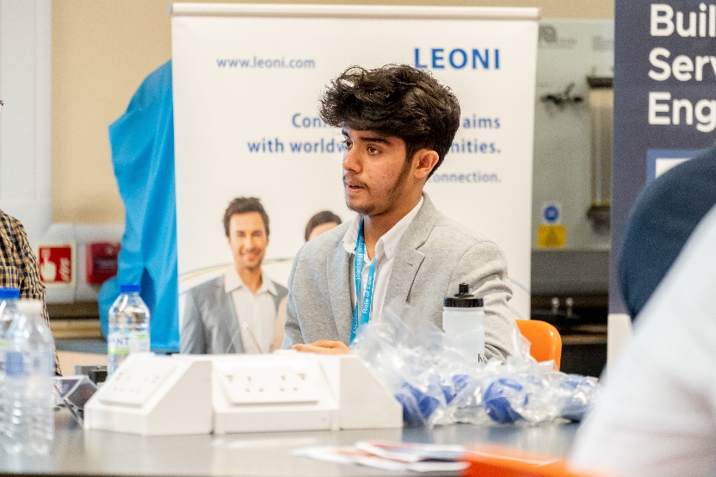
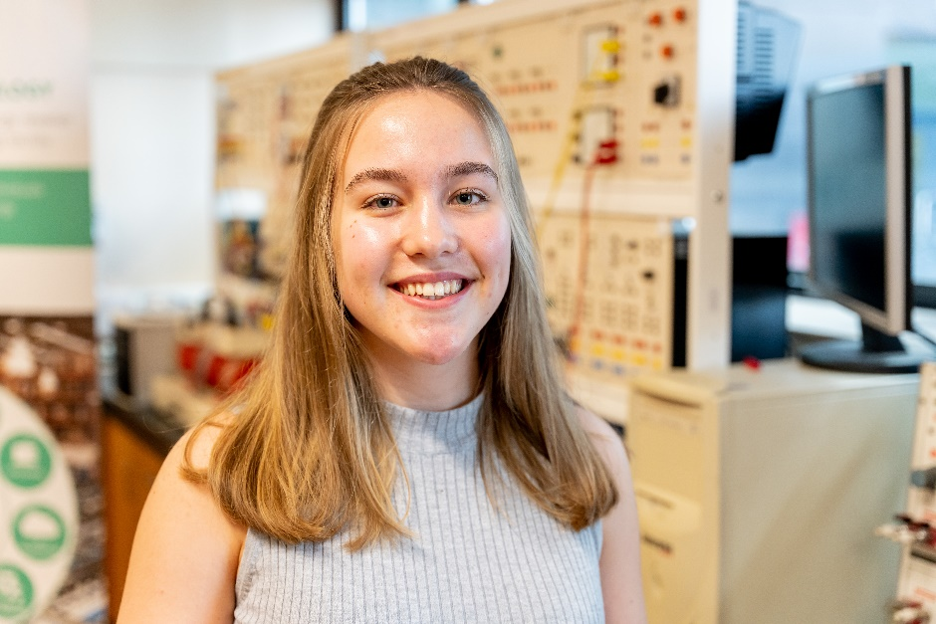
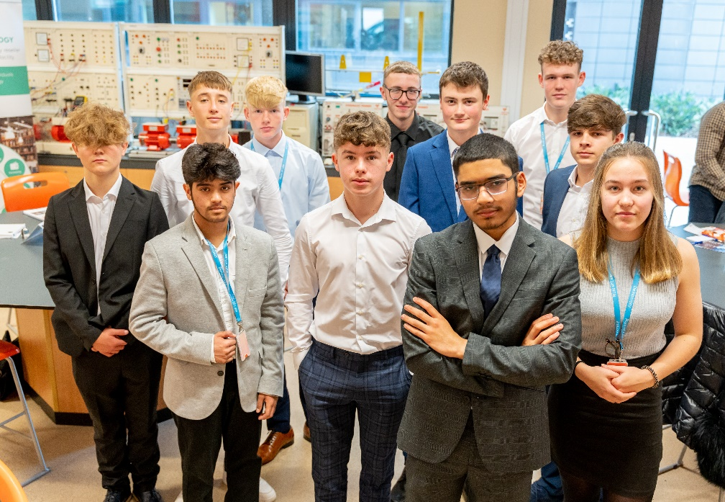
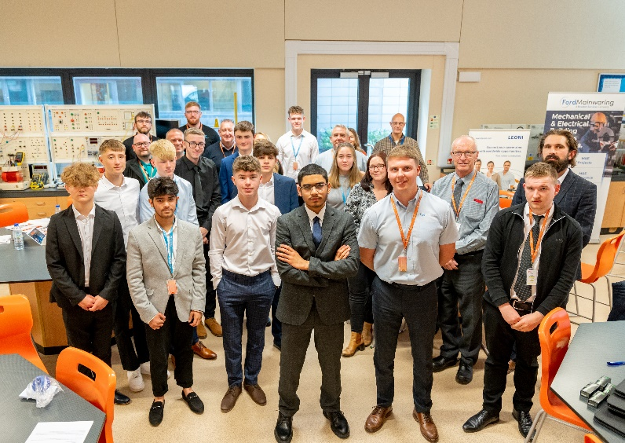
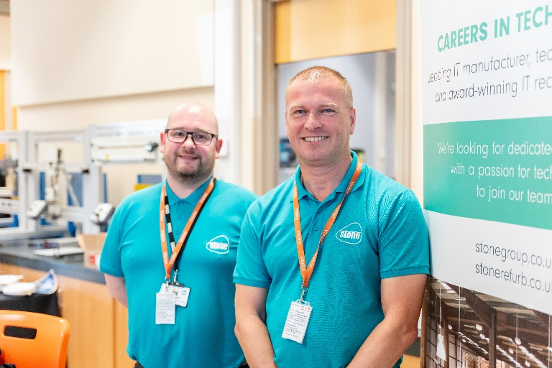
Engineering Employer Event

Slide 20
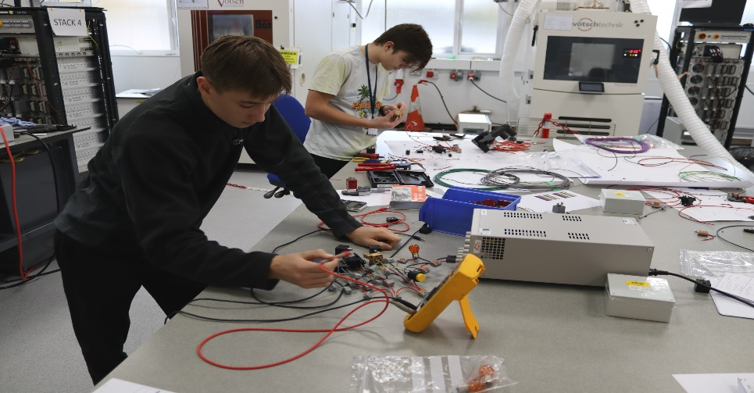
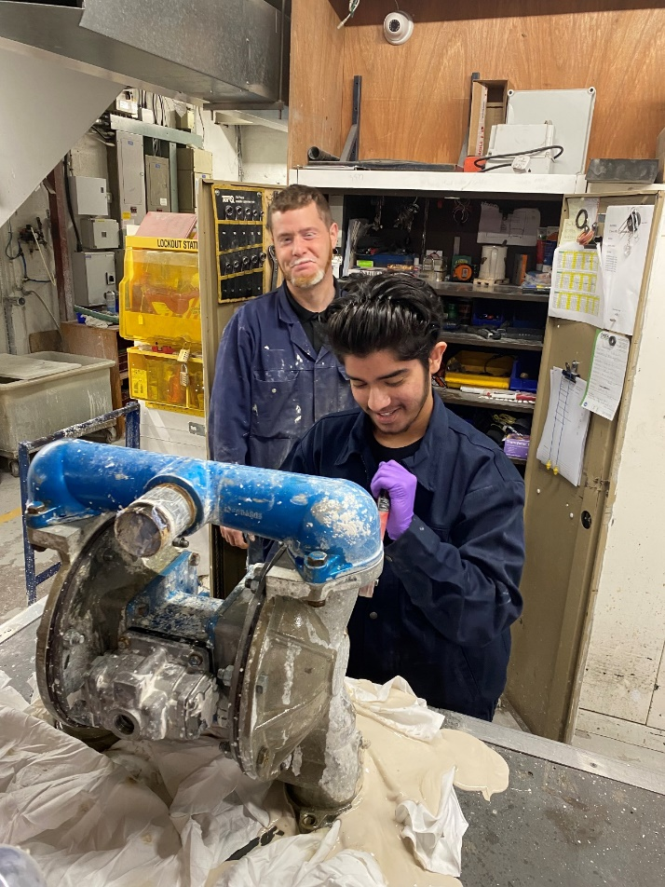

Industry Placements
Leoni
Portmeirion
C 2 C Engineering

Slide 21
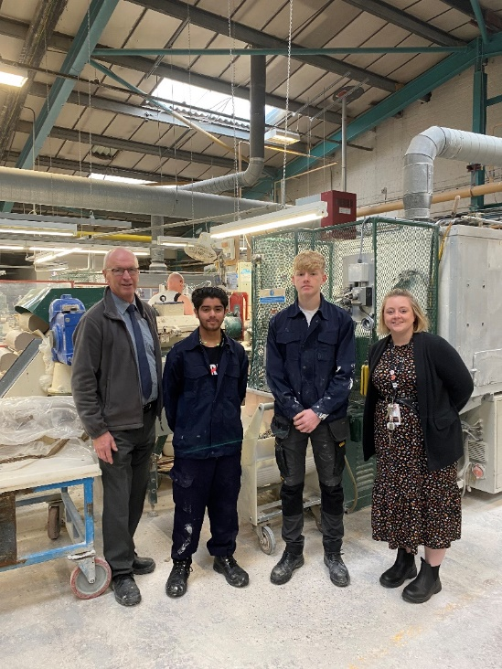
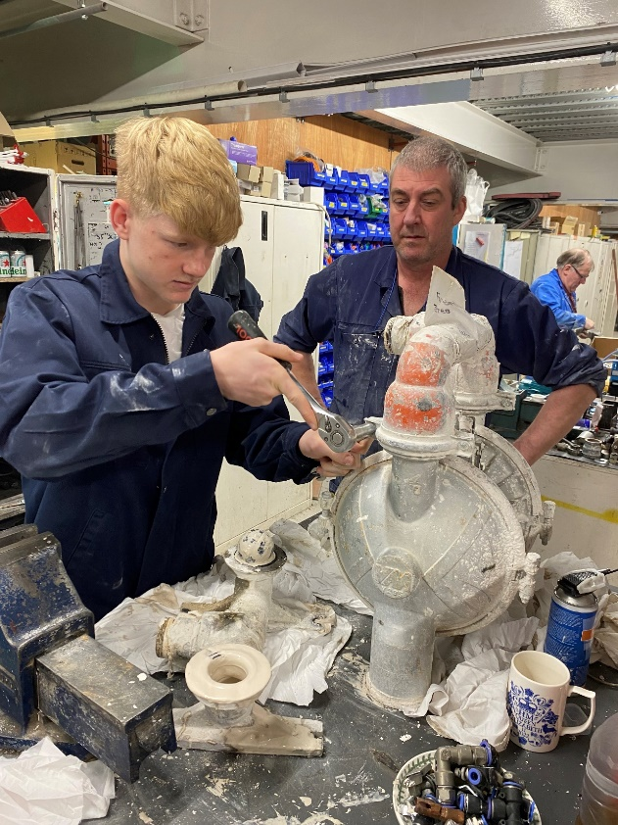
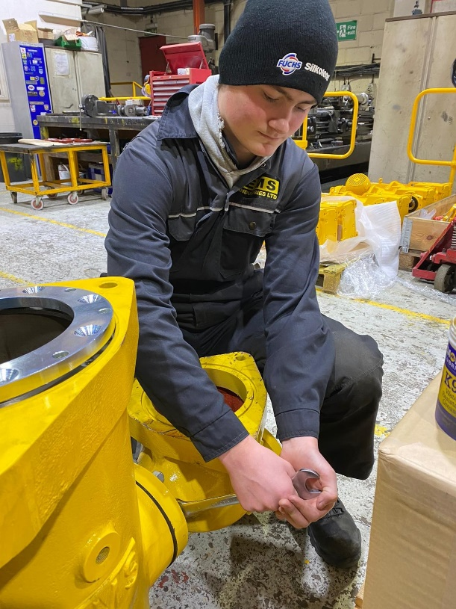
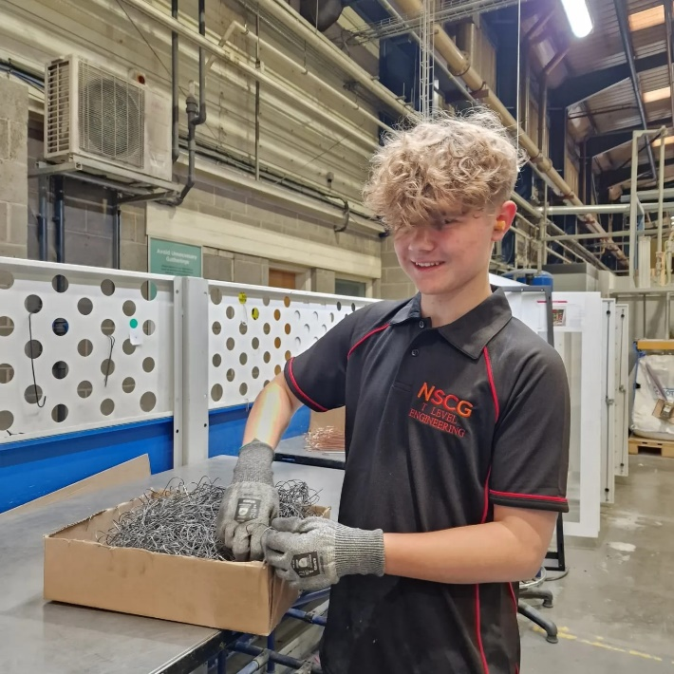
Industry Placements
KMF
EMS Engineering

Slide 22

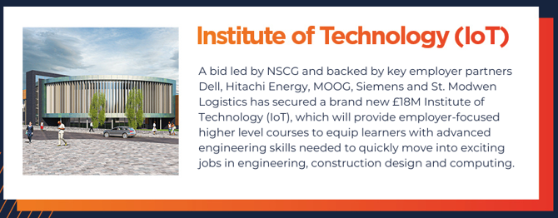
Progression:
Next steps
Apply on line - https://nscg.ac.uk/
Next Open Events – 9th October & 14th November
Interview process
Taster sessions
  Higher Technical Qualifications – Including HNC, HND and Degrees
  University
  IOT
  Higher Apprenticeships and specialist pathways
  Employment

Slide 23



Stoke-on-Trent and Staffordshire Careers Hub
‘School Improvement through the lens of careers – a talent pipeline for business recruitment’

Slide 24
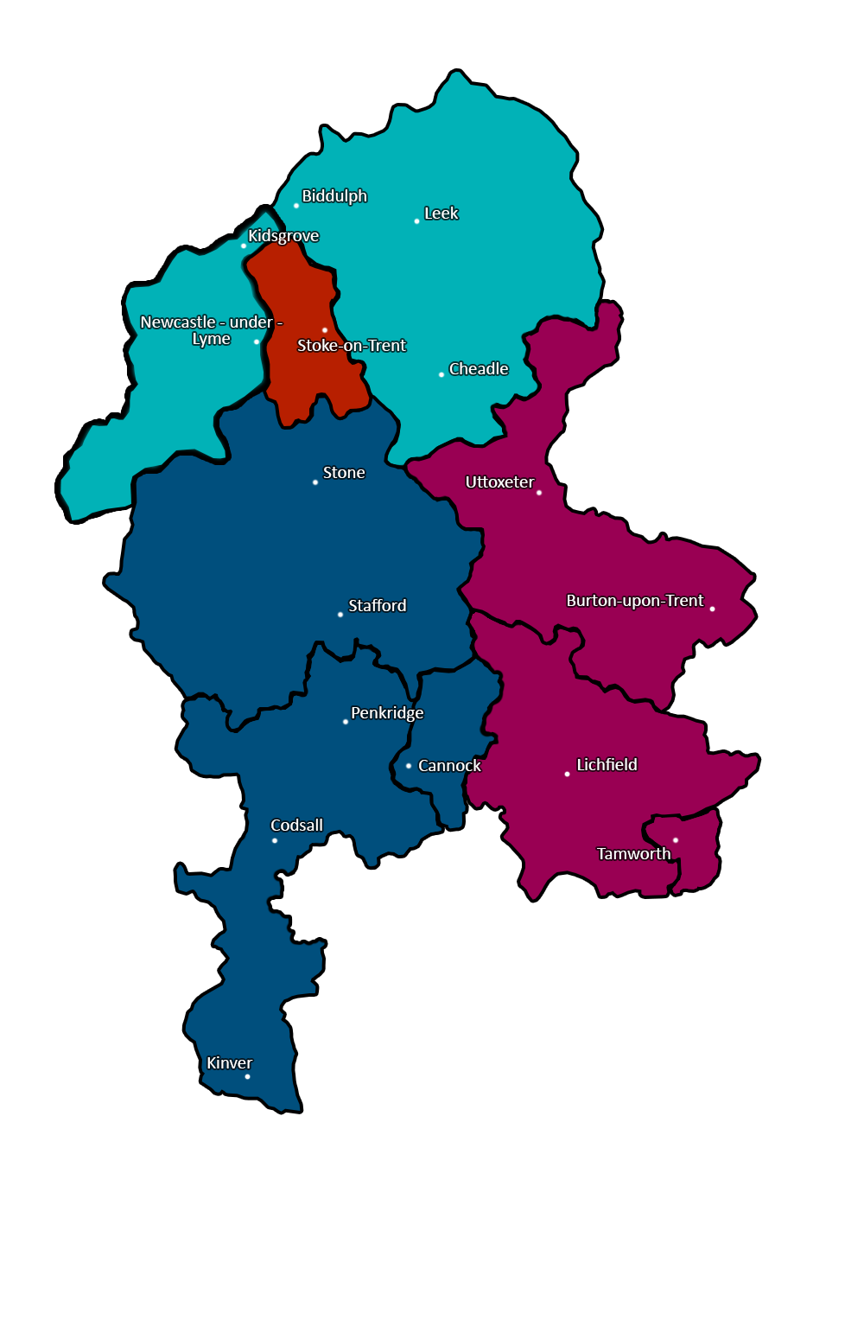
Stoke and Staffordshire Careers Hub…
4 Localised Hub Districts
116 Schools in Stoke and Staffordshire
96 Schools including Mainstream, SEND, PRU in the hub
72 Enterprise Advisers (Business Volunteers)
5 System Change Careers Hub Projects known as ‘ Big Ticket’
“INCREASING careers activity is not the same as IMPROVING careers provision”
Notes:
Systemic change happens when we have a number of things in place
the 3Ps,
the BM’s as continuous improvement,
top down and bottom up modelling
- Its essential for whole school influence - that vision setting is done at leadership level.
- Positioning careers headteacher down gives accountability
Having both a strategic career lead and an operational careers lead shifts the responsibility whole school
leads to impact driven projects attached to school improvement priorities.
Are our young people prepared for the world of work. Can our businesses recruit from a rich talent pool?
Careers can be just stuff that happens but with just simple changes to the system we can see real outcomes for our young people.
What we have in our county is a significant shift towards this with almost 80% of our hub schools working towards this model - but our ambition is for all schools.
Thank you – so enough from me - i would like to ask Liz Todd to the stage who can talk to you about some of the impact they have seen at St Thomas More
Welcome Liz. Thank you.

Slide 25
Gatsby Benchmarks…
A stable careers programme
Learning from career and labour market information
Addressing the needs of each pupil
Linking curriculum learning and careers
Encounters with employers and employees
Experiences of workplaces
Encounters with further and higher education
Personal Guidance
1.
2.
3.
4.
5.
6.
7.
8.
6144_Gatsby_career_2014_AW.indd

Slide 26
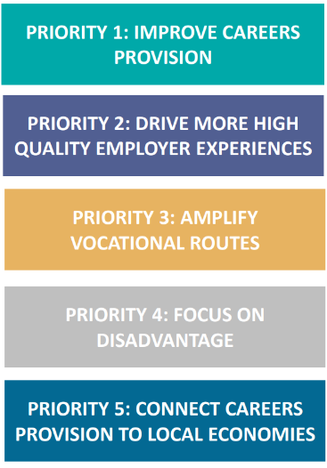
National Department for Education (DfE) Priorities
Raise the quality of careers provision in schools and colleges against the Gatsby Benchmarks through training for the education workforce, targeted support and quality assurance
Provide more high-quality experiences with employers for students and teachers - with a focus on current areas of need
Amplify apprenticeships, technical and vocational routes - including by supporting Provider Access Legislation
Target interventions for economically disadvantaged young people (Free School Meals) and those who face barriers
Connect careers provision in schools and colleges to the needs of local economies (as articulated through Local Skills Improvement Plans (LSIPs))
Notes:
Systemic change happens when we have a number of things in place
the 3Ps,
the BM’s as continuous improvement,
top down and bottom up modelling
- Its essential for whole school influence - that vision setting is done at leadership level.
- Positioning careers headteacher down gives accountability
Having both a strategic career lead and an operational careers lead shifts the responsibility whole school
leads to impact driven projects attached to school improvement priorities.
Are our young people prepared for the world of work. Can our businesses recruit from a rich talent pool?
Careers can be just stuff that happens but with just simple changes to the system we can see real outcomes for our young people.
What we have in our county is a significant shift towards this with almost 80% of our hub schools working towards this model - but our ambition is for all schools.
Thank you – so enough from me - i would like to ask Liz Todd to the stage who can talk to you about some of the impact they have seen at St Thomas More
Welcome Liz. Thank you.

Slide 27
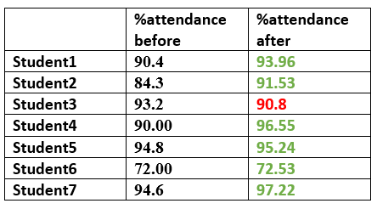
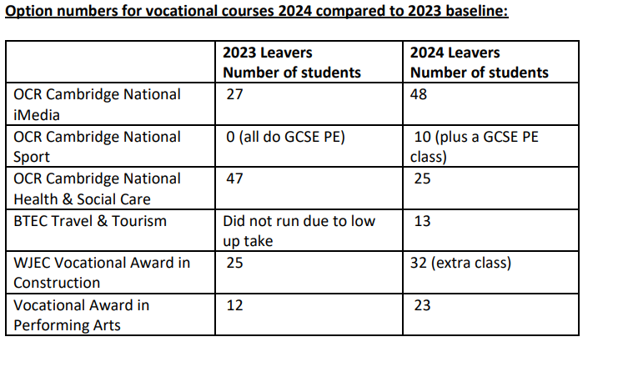
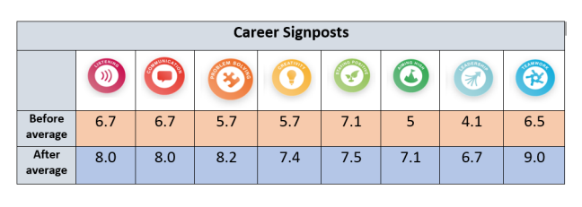
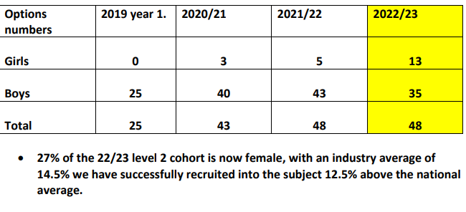
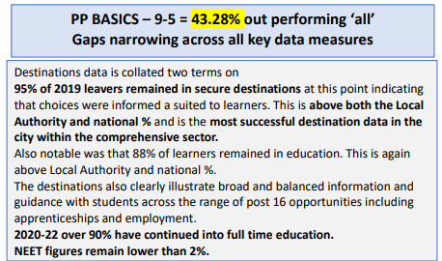
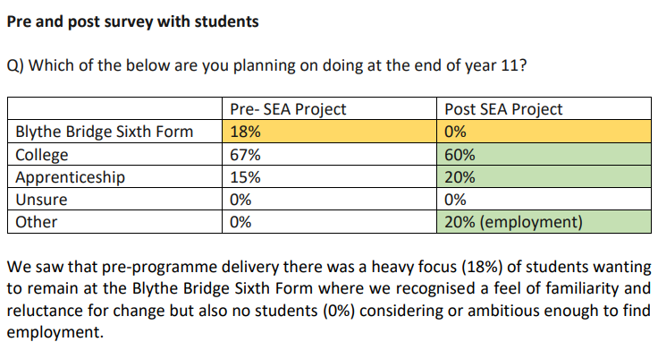
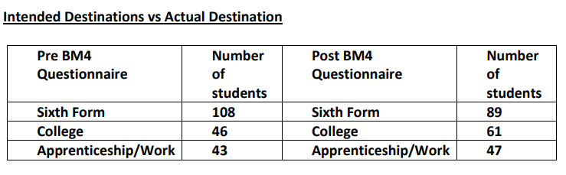
2 - Hub Impact Projects – Outcomes
Notes:
The outcome:
15 Impact projects successfully delivered in Phase 1. Each one has a written guide and resources saved on our Portal for Careers Leaders & EAs to use in their respective schools.
Some highlights:
Leek High School – Improved attendance in Y10 RONI students through a bespoke raising aspirations program.
The Orme – Increased uptake of technical and vocational pathways available by engaging with parents and teachers to increase their understand of T&V pathways in general.
Wolgarston – Saw a shift in intended destinations away from the school VI form, to Apprenticeship and Vocational Routes following a whole school push to embed LMI into curriculum.
Blythe Bridge – Saw a shift in intended destinations for a targeted group of SEND students, moving away from the school VI form where it was believed they felt most comfortable, towards more suitable destinations. This was achieved using bespoke raising aspirations program based on the Skills Builder Framework.
ST Thomas Moore – Implemented changes to improve the 1-2-1 careers guidance process in school which led to increased attainment of PP students.
Great Wyrley – Using targeted awareness raising of engineering sector to Y8 and Y9 girls, they increased the number of girls doing GCSE engineering to 27% of total numbers, compared to companies employing on average just 12.5% females in their workforce.
Phase 2 Summary:
• Began in October 2022 and some tweaks were made to the scheme.
• Schools could bid to deliver more than one project each worth up to £2000.
• There was a change in strategic priorities, each bid had to align with one of four main categories: tackling disadvantage, raising attainment in classroom, positive impact on behaviours & positive progression.
• So far 8 projects were delivered and submitted for phase 2 and were currently planning what phase 3 is going to look like for October 2023.
• Two highlights from Phase 2 – Attendance of 50 RONI students from across the whole school improve by 60%.
• 25 % reduction in repeat exclusions among year 9 & Y10 students.

Slide 28
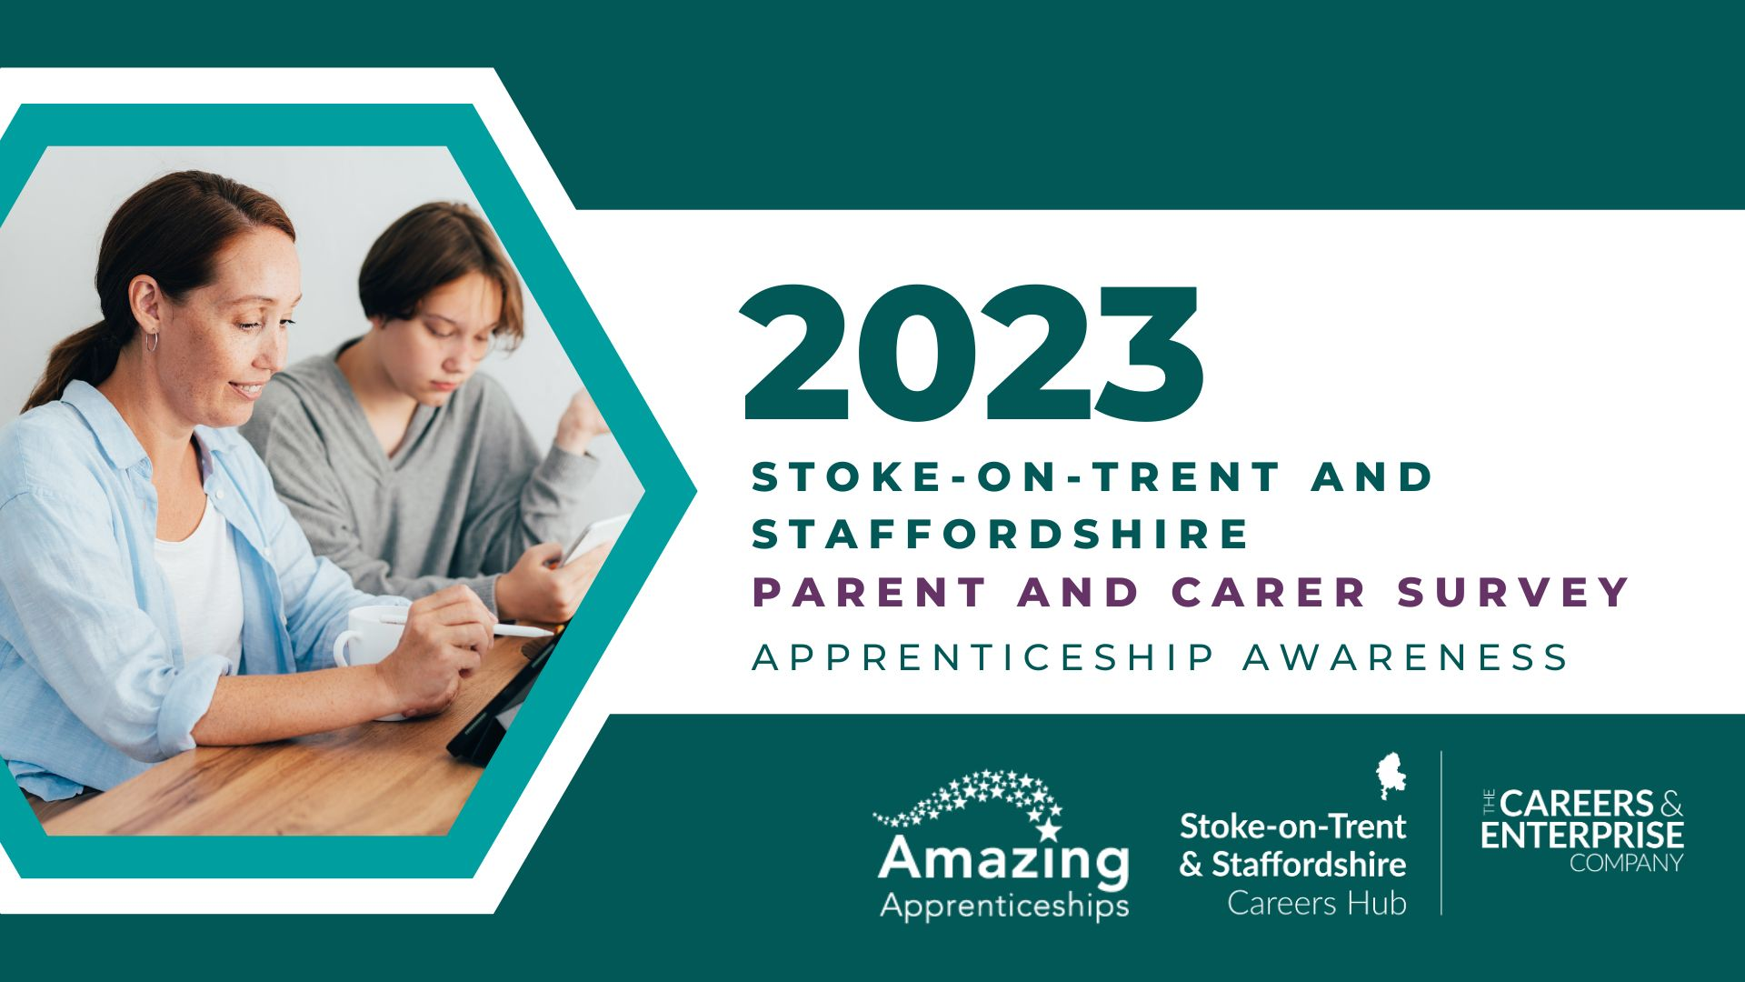
Teacher and Parent Vocational Pathways Survey
Notes:
Systemic change happens when we have a number of things in place
the 3Ps,
the BM’s as continuous improvement,
top down and bottom up modelling
- Its essential for whole school influence - that vision setting is done at leadership level.
- Positioning careers headteacher down gives accountability
Having both a strategic career lead and an operational careers lead shifts the responsibility whole school
leads to impact driven projects attached to school improvement priorities.
Are our young people prepared for the world of work. Can our businesses recruit from a rich talent pool?
Careers can be just stuff that happens but with just simple changes to the system we can see real outcomes for our young people.
What we have in our county is a significant shift towards this with almost 80% of our hub schools working towards this model - but our ambition is for all schools.
Thank you – so enough from me - i would like to ask Liz Todd to the stage who can talk to you about some of the impact they have seen at St Thomas More
Welcome Liz. Thank you.

Slide 29
Key finding from last years questionnaires
Teachers 1500 responses
Most teachers were having conversations about future pathways
Teachers were more confident when talking to students about A Levels and University and less so about apprenticeship and T-Level options.
Majority felt they needed to know more about local labour market.
Parents & Carers 5,600 responses
Majority did not feel confident in how to support their child to apply for an apprenticeship.
Biggest questions parents/carers had related to knowing how to support their child to choose the right option.
67% parents/carers want to be kept informed about apprenticeships and other local opportunities.
Notes:
From the staff questionnaire findings, 9/10 Teachers are having career conversations with students – GREAT! Isn’t it?
Yes until you look at the next figure of 1127 staff are not confident with discussing information around the Local Labour Market. Are they aware of what the growth sector areas are? Do they know how to approach and engage with local employers to embed careers into their lessons, curriculum and student conversations?
Expectedly, they are confident with A Level and university conversations.
I was quite surprised that only 5/10 feel confident with conversations around apprenticeships and expected that 4/10 felt confident discussing T Level options.
The parent and carer findings highlight big gaps in knowledge across the board so there is definitely work to be done here to support parents and carers with the relevant knowledge and confidence to be able to have career conversations with their children.

Slide 30

Careers Hub Response
Careers Hub working with school SLT, and other key stakeholders i.e. ASK, WMAAN, SPES, LSIP, Employers to campaign for countywide consistent messaging around parent and carer engagement and ATE understanding.
Developed webinars aimed at increasing awareness amongst teachers, students and parents of opportunities available, what skills employers were looking for and how to apply.
Develop a universal communication pack for all schools to send to all parents at varying key stage transition points
Notes:
Next Steps:
The questionnaires have enabled us to capture our start point so that what we deliver now is a response to that data set. This will then help us to gauge and record the impact of our activities.
We have already started working on how we are supporting education staff. We put out to tender the opportunity to write and deliver a campaign to be delivered to school and college staff from across Staffordshire. All of the feedback from the staff was taken in to account as to how they wanted to receive the training, information and updates. Ben Calvert Lyons from the Training Initiative was successful in the bid and working with a panel of our Enterprise Advisers, current apprentices and a college, has delivered the first of our 4 webinars for staff to find out more about Apprenticeships and T-Levels
The questionnaires have enabled us to have detailed conversations with our schools around staff CPD and also parental engagement.

Slide 31
Parent Survey 2023/24
3,700 parent responses
180 from Sir Graham Balfour parents
Schools will with more than 20 responses will get individual school reports for both their teacher and parent survey.
Notes:
Next Steps:
The questionnaires have enabled us to capture our start point so that what we deliver now is a response to that data set. This will then help us to gauge and record the impact of our activities.
We have already started working on how we are supporting education staff. We put out to tender the opportunity to write and deliver a campaign to be delivered to school and college staff from across Staffordshire. All of the feedback from the staff was taken in to account as to how they wanted to receive the training, information and updates. Ben Calvert Lyons from the Training Initiative was successful in the bid and working with a panel of our Enterprise Advisers, current apprentices and a college, has delivered the first of our 4 webinars for staff to find out more about Apprenticeships and T-Levels
The questionnaires have enabled us to have detailed conversations with our schools around staff CPD and also parental engagement.

Slide 32



Slide 33
Placements within the workplace
Our aim is to ensure that placements are meaningful for both the students and the employers involved.
Workplace tour
Q&A session with employees
Workshop activity

Slide 34
Parent Survey 2023/24
50 employers across Stoke on Trent and Staffordshire
Target is for 1,400 experiences of the work place.
SBG has organised placesments for 10 students this half term.
Notes:
Next Steps:
The questionnaires have enabled us to capture our start point so that what we deliver now is a response to that data set. This will then help us to gauge and record the impact of our activities.
We have already started working on how we are supporting education staff. We put out to tender the opportunity to write and deliver a campaign to be delivered to school and college staff from across Staffordshire. All of the feedback from the staff was taken in to account as to how they wanted to receive the training, information and updates. Ben Calvert Lyons from the Training Initiative was successful in the bid and working with a panel of our Enterprise Advisers, current apprentices and a college, has delivered the first of our 4 webinars for staff to find out more about Apprenticeships and T-Levels
The questionnaires have enabled us to have detailed conversations with our schools around staff CPD and also parental engagement.

Slide 35










Time Management
Communication
Self Awareness
Team Work
Employer
Competency Framework
Resilience
Positivity
Honesty
Problem Solving
Can-do Attitude
Confidence

Slide 36
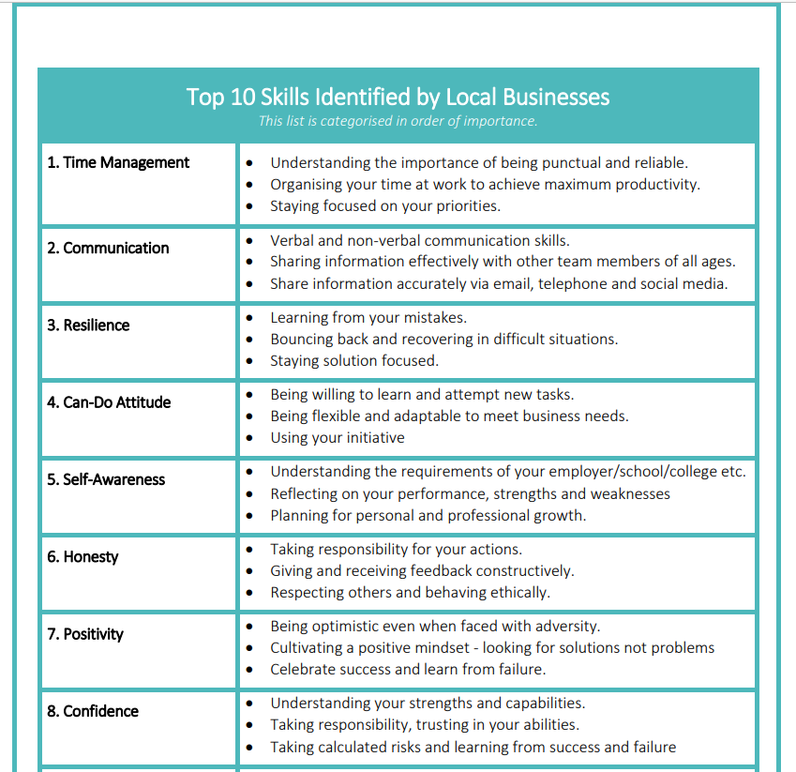
Employer
Competency Framework
Notes:
Next Steps:
The questionnaires have enabled us to capture our start point so that what we deliver now is a response to that data set. This will then help us to gauge and record the impact of our activities.
We have already started working on how we are supporting education staff. We put out to tender the opportunity to write and deliver a campaign to be delivered to school and college staff from across Staffordshire. All of the feedback from the staff was taken in to account as to how they wanted to receive the training, information and updates. Ben Calvert Lyons from the Training Initiative was successful in the bid and working with a panel of our Enterprise Advisers, current apprentices and a college, has delivered the first of our 4 webinars for staff to find out more about Apprenticeships and T-Levels
The questionnaires have enabled us to have detailed conversations with our schools around staff CPD and also parental engagement.

Slide 37

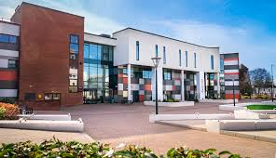

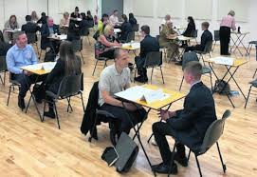
Opportunities
University trips
College trips
Webinars
Employer encounters
Careers fair
Mock Interviews
1-1 guidance…

Slide 38
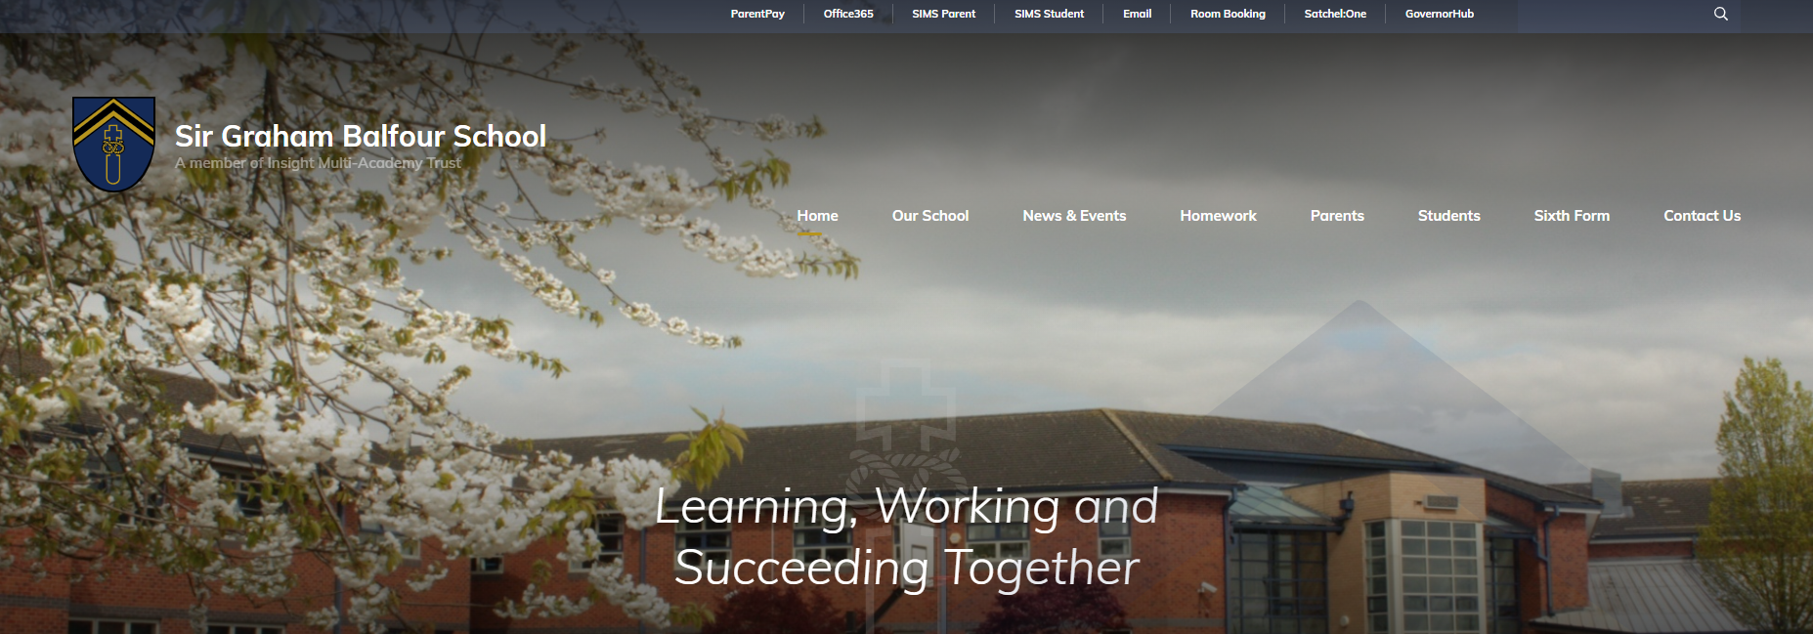

Slide 39
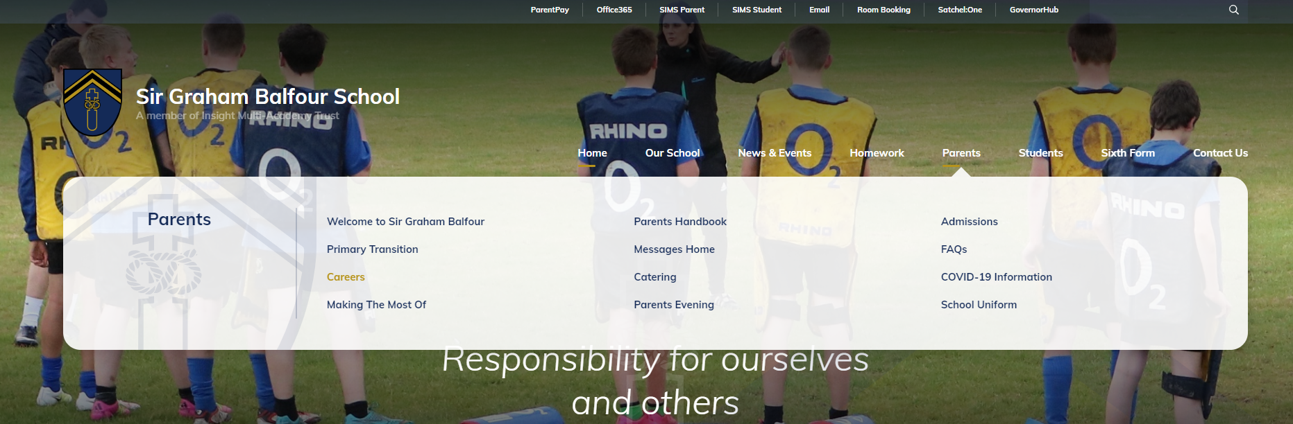

Slide 40
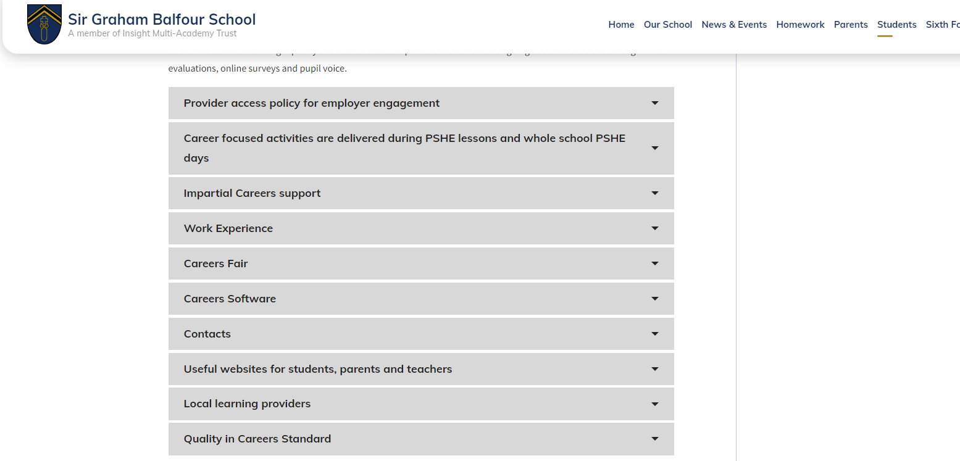

Slide 41
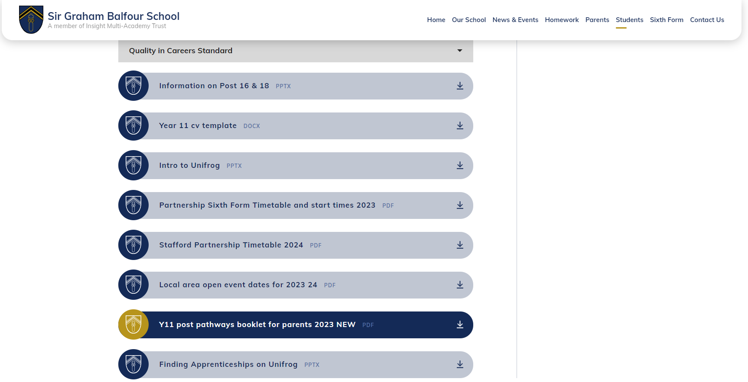

Slide 42


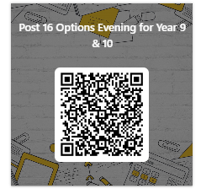
Questions?
Thank you for coming
We value your feedback
Dates for your diary
5th July Art and DT exhibition.
Big walk for Cambodia

